Slide 1


Some recent results on statistical distances
Principles and geometry
Frank Nielsen
Sony Computer Science Laboratories Inc
Tokyo, Japan
May 2024

Slide 2
Outline
I. Background:
Divergences are everywhere in information sciences for different purposes!
Principles of
① f-divergences
② Bregman divergences
③ Rao distance
II. In this talk, recent advances via three concepts:
Fisher-Rao distances and ① projective distances
Bregman divergences and ② comparative convexity
f-divergence analysis via ③ maximal invariant
Notes:
① ② ③.

Slide 3
Why statistical distances in information sciences?
Probability theory: convergence theorems wrt probability metrics
Statistics:
Divergence-based estimators: dissimilarities between empirical distributions and models
Scoring rules: evaluates forecasts, probabilistic predictions
Information theory: Mutual information of random variables
Signal processing: Decompositions, approximate matrix factorization: NMF via β-divergence in sound processing, etc.
Machine learning, pattern recognition: Loss functions for training models, optimal transport, Integral probability metrics (MMDs)
Information geometry: canonical divergences of geometric structures, geometry of divergences

Slide 4
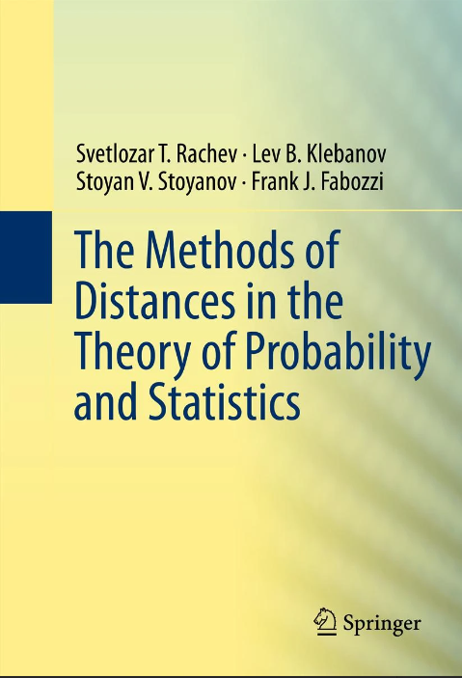


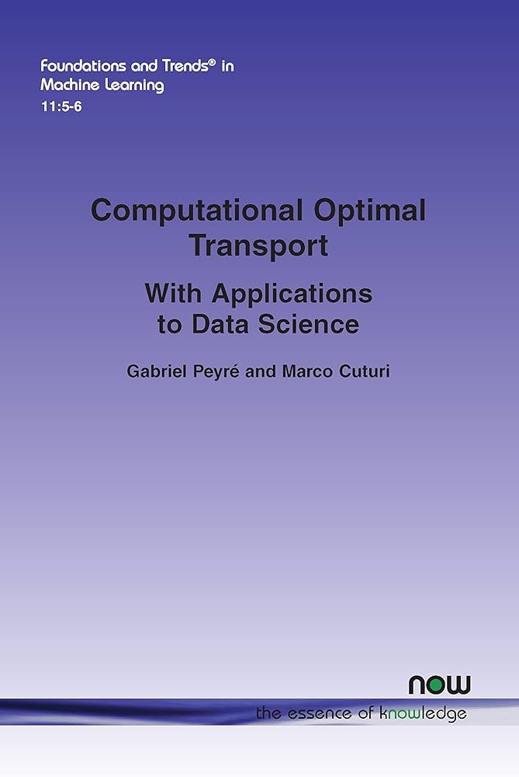
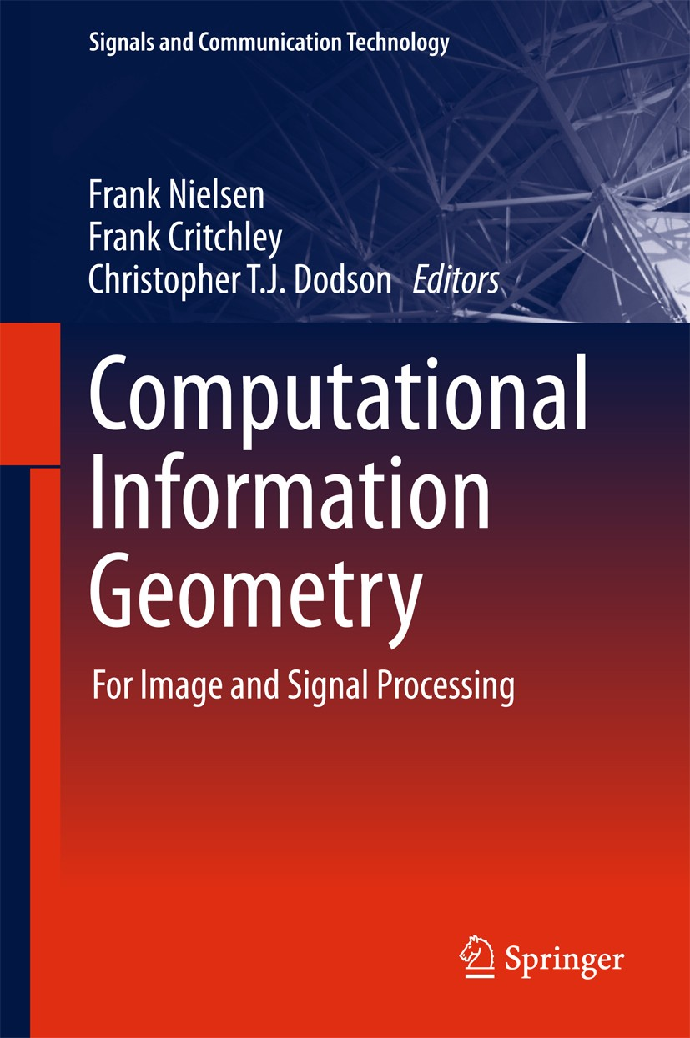

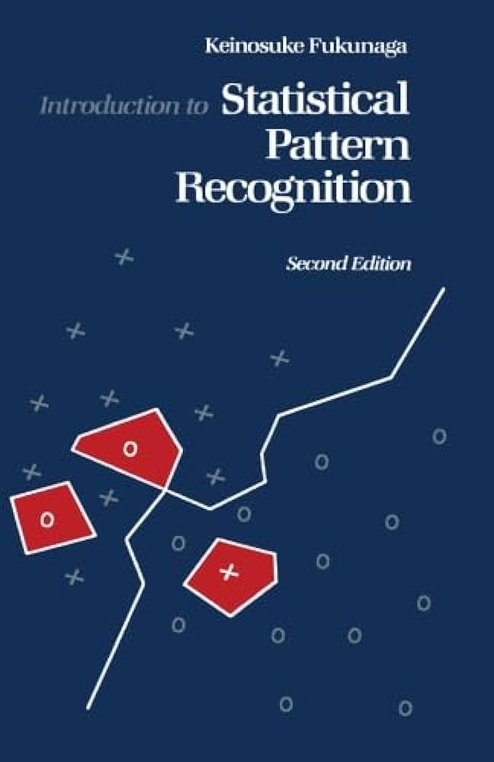
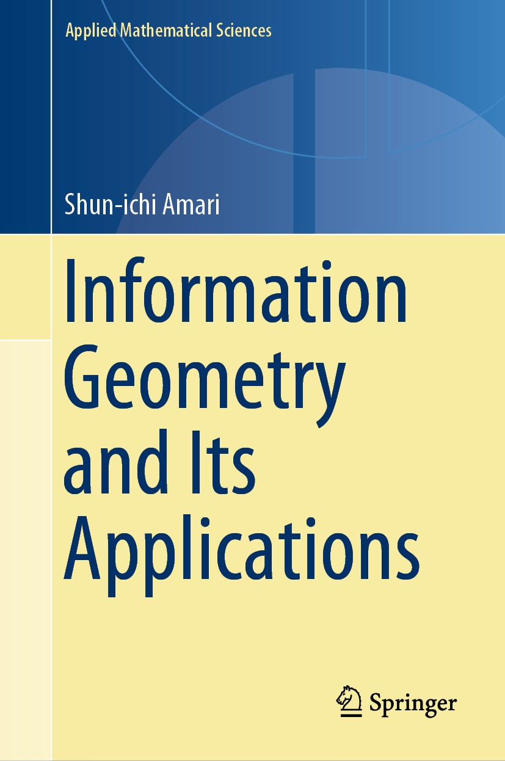

Statistical distances in information sciences
Probability theory
Statistics
Information theory
Optimal transport
Signal processing
Machine learning
Pattern recognition
Information geometry

Slide 5
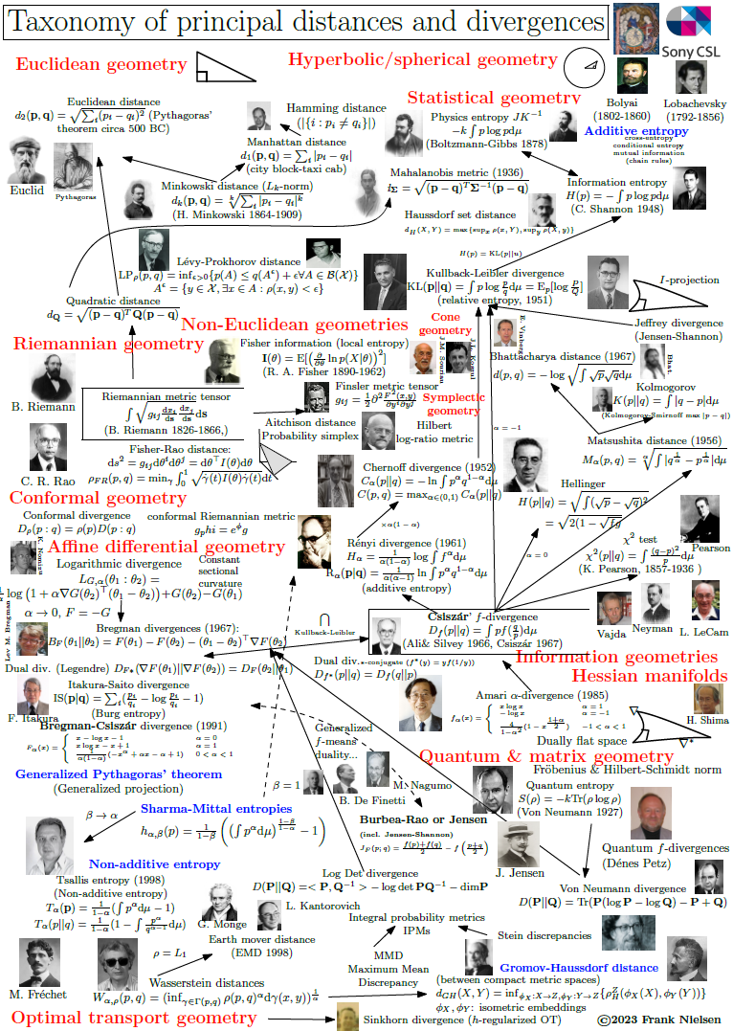

Historically, many distances with purposes…
https://franknielsen.github.io/Divergence/index.html

Slide 6
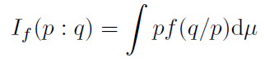
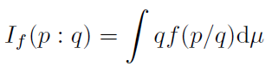
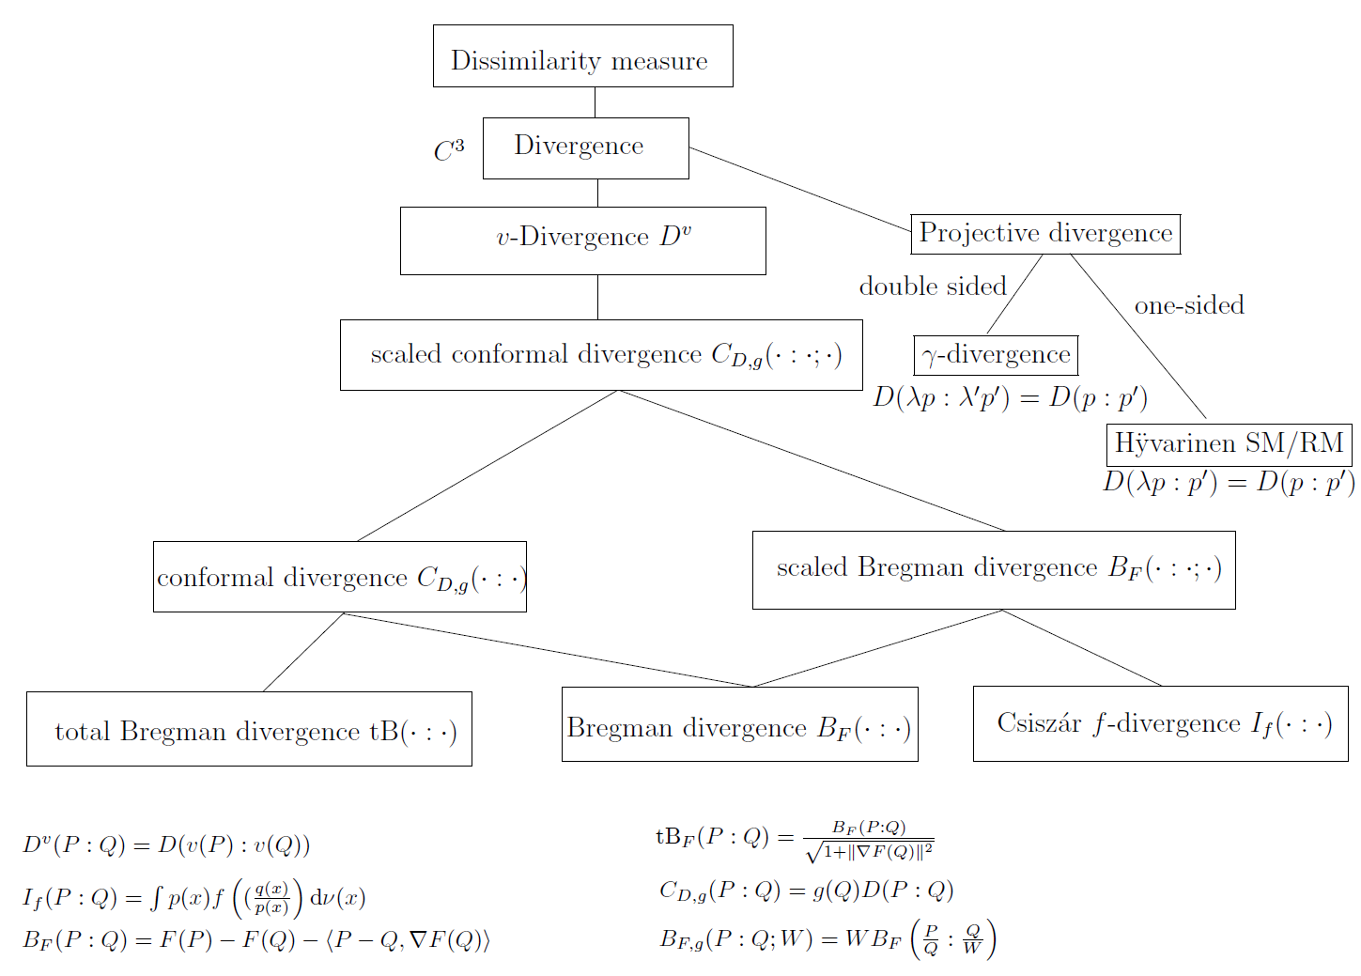
Seeking principles and properties of distances
f convex, strictly convex at 1
f-divergences (Ali-Silvey & Csiszár)
Only separable distances which are monotone under Markov kernels
Invariant under ``sufficiency’’
Bregman divergences
Only distances with right-sided centroids = centers of masses
Canonical divergences of dually flat spaces in information geometry
Transport distances including Wasserstein distances
Minimize transport cost wrt a ground distance
Fast regularized OT with dense plan, fast sparse reg. OT
F strictly convex and smooth
Csiszár, "On information-type measure of difference of probability distributions and indirect observations," Studia Sci. Math. Hungar. 2 (1967).
Bregman, "The relaxation method of finding the common point of convex sets and its application to the solution of problems in convex programming", USSR computational mathematics and mathematical physics 7.3 (1967)
Kantorovich, "Mathematical methods of organizing and planning production," Management science 6.4 (1960)
Nielsen, "An elementary introduction to information geometry", Entropy 22.10 (2020)

Slide 7
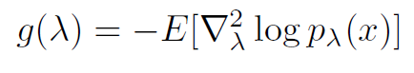
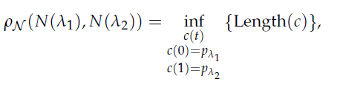
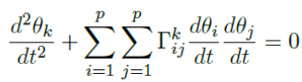
Fisher-Rao geodesic metric distances
Statistical model {p_{λ:} λ∈Λ} with model dimension dim(Λ)=m
Use Riemannian geodesic distance for the Fisher metric expressed in chart (λ,Λ) using Fisher information matrix:
Pro:
Invariant to reparamerization: a geometric distance!
Role of Riemann-Christoffel, Ricci, sectional curvatures in statistics
Con: Can be difficult to calculate: eg, no formula for multivariate Normals, autodiff
Fisher length of a curve:
Geodesic is locally length minimizing curve:
Fisher-Rao distance = Fisher length of geodesic
Geodesic wrt Fisher Levi-Civita connection:
Solve ODE with:
Initial value problem or
Boundary value problem
Notes:
$$
g(\lambda)=-E[\nabla_\lambda^2\log p_\lambda(x)]
$$
$$
I_f(p:q)=\int p f(q/p)\dmu
$$
$$
I_f(p:q)=\int q f(p/q)\dmu
$$

Slide 8
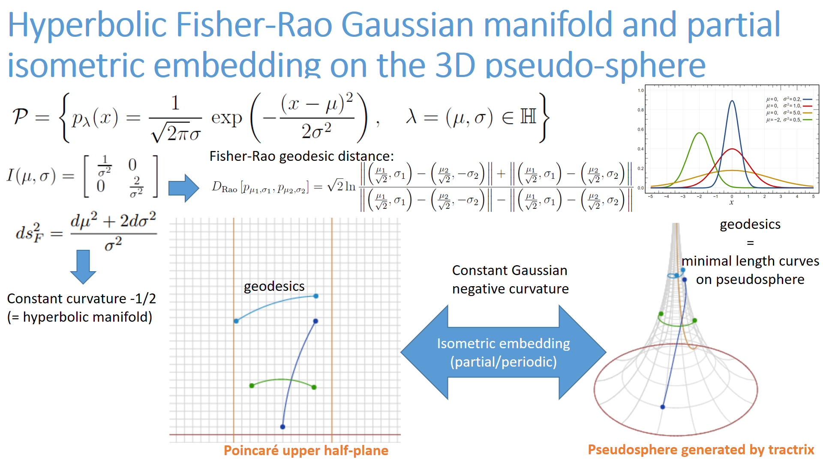
Only this band can be
embedded as a 2D surface of 3D
κ=-1/2
U
Notes:
Fisher-Rao geometry of statistical model of univariate normal distributions amounts to Poincaré hyperbolic upper plane U. Isometric embedding of a *band* of U onto the pseudosphere of negative curvature. Hilbert proved that no full isometric embedding of U in R3 is possible.

Slide 9
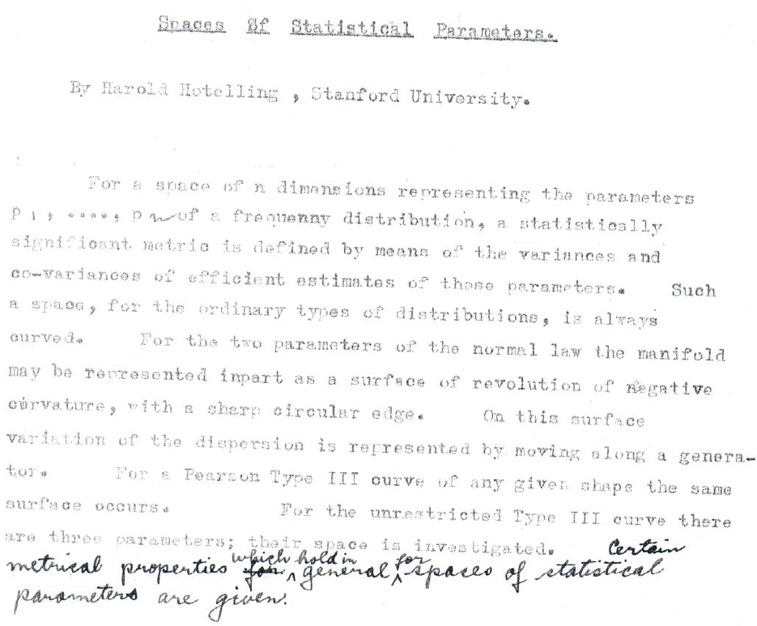
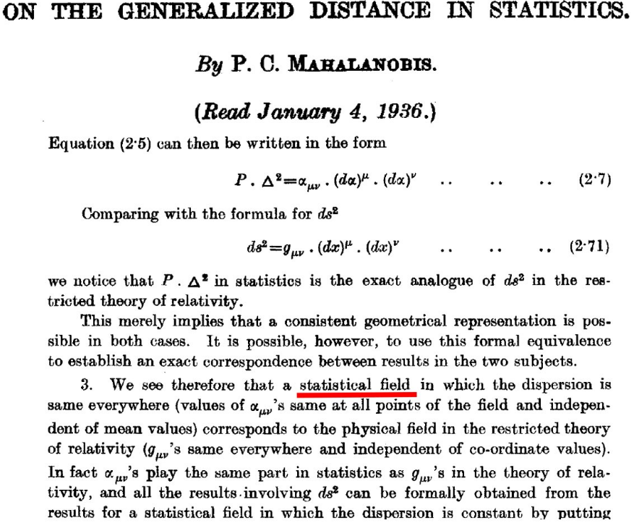
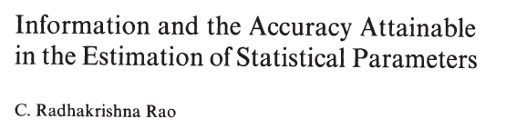
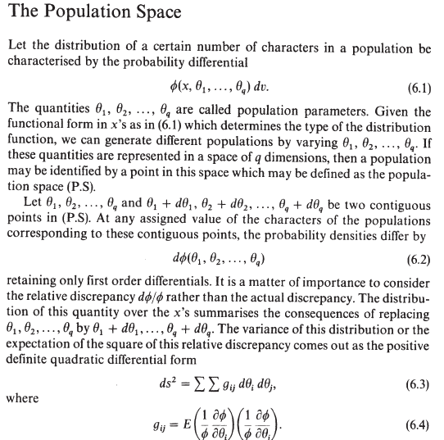
Precursors of statistical manifolds/information geometry
[Hotelling 1930]
Space of statistical parameter
[Mahalanobis 1936]
Statistical field
[Rao 1945]
Population space
Notes:
Precursors of statistical manifolds in information geometry:
- Space of statistical parameter by Hotelling (1930)
- Statistical field by Mahalanobis (1936)
- Population space by Rao (1945)
----
use tensor notations

Slide 10
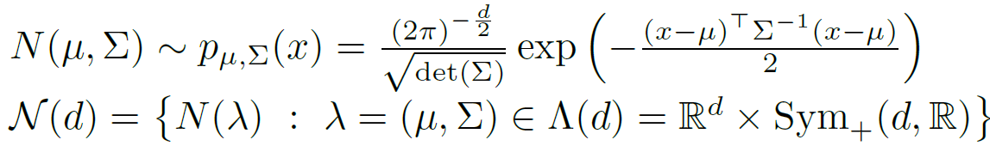
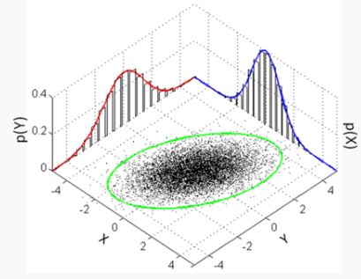
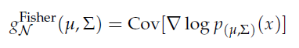
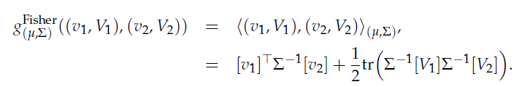
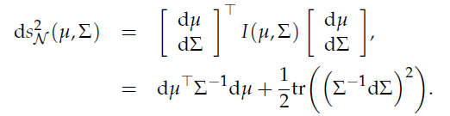

Fisher-Rao geometry: multivariate normals (MVNs)
Fisher information matrix (vector, matrix):
Fisher metric tensor:
v= vector space R^{d}
V=Symmetric matrix
vector space
Length element:
[Skovgaard 1984]
Non-constant sectional curvatures which can also be positive, not a NPC space (d>1)

Slide 11
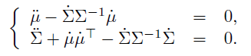
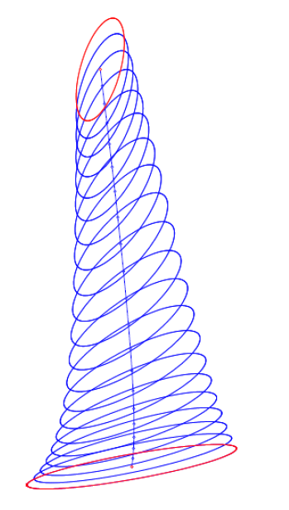
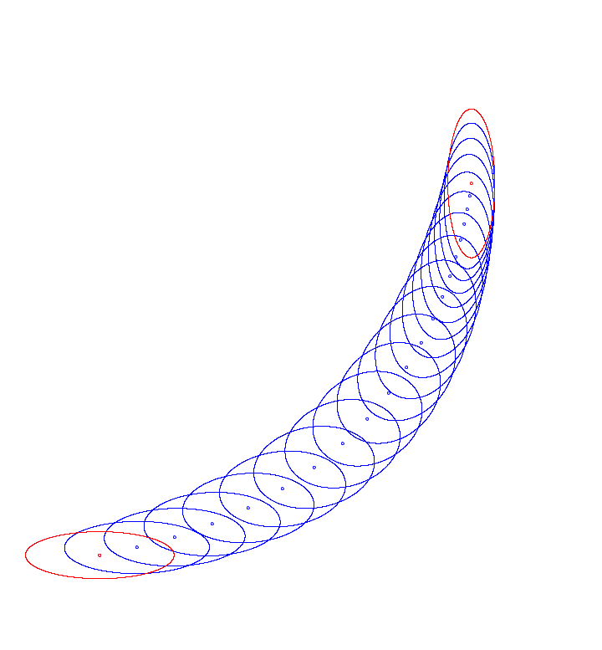
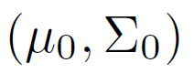
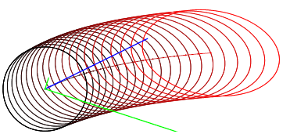
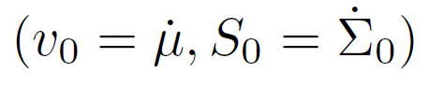
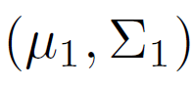
Fisher-Rao geodesic equation for MVNs:
Using (vector, Matrix) parameterization:
Second-order ODE:
Consider either initial value conditions or boundary value conditions of ODE
Yet, once Fisher-Rao geodesics are known, integrate Fisher-Rao length elements to get Rao distance.
[Boundary values, 2023]
Source+target
[Initial values, 1987]
Source+tangent vector
MVN: No closed form yet…

Slide 12
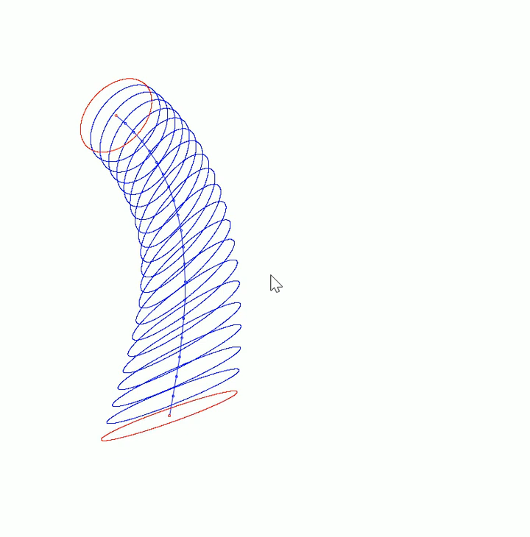
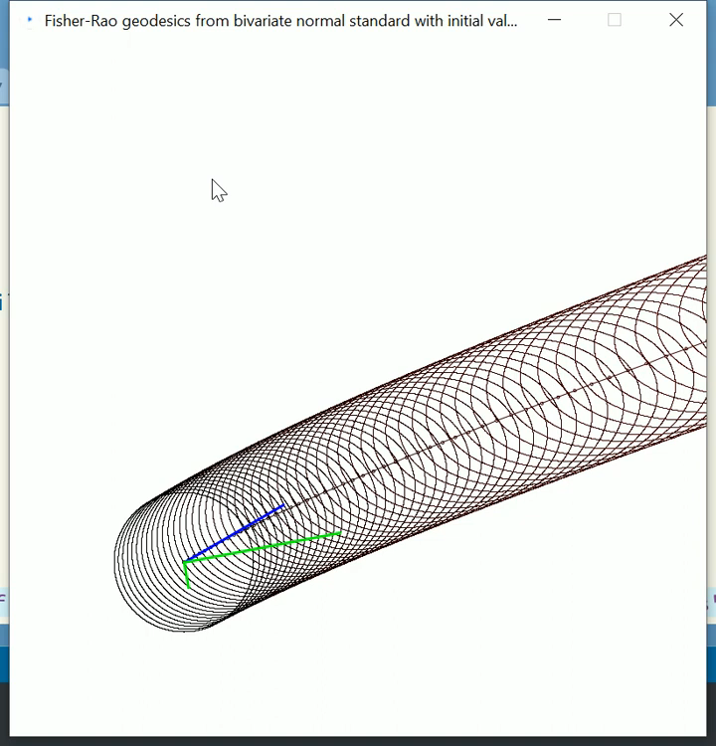
Demos: MVN Fisher-Rao geodesics on bivariate normal Fisher-Rao manifold
Geodesics with initial values
Geodesics with boundary values

Slide 13
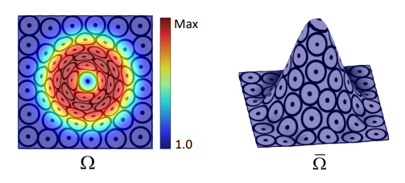
Strategy to get lower bounds on Fisher-Rao distances
Nash embedding theorem: A Riemannian manifold (M,g) of dimension m can always be embedded in Euclidean space (E,g_{Euclidean}) of dimension O(m³).
Let S={f(p), p ∈ M} be the submanifold. If geodesics between f(p) and f(q) stay in S wrt g_{Euclidean} then the manifold is totally geodesic
Riemannian distance in (E,g_{Euclidean}) is ||f(p)-f(q)||₂
Rao distance in (M,g) lower bounded by ||f(p)-f(q)||₂ :
We may embed (M,g) into high-dimensional non-Euclidean manifolds (M’,g’) too (next slide!) and get
2D manifold embedded in 3D
Intrinsic
2D manifold
Figure from
[Zhong et al’ 2018]
ρ(p,q) ≥ ||f(p)-f(q)||₂
ρ_{M}(p,q) ≥ ρ_{M’}(f(p),f(q))
Notes:
https://www.researchgate.net/publication/326729830_Computing_a_high-dimensional_euclidean_embedding_from_an_arbitrary_smooth_riemannian_metric

Slide 14
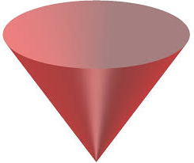
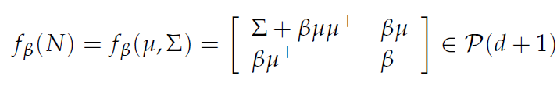
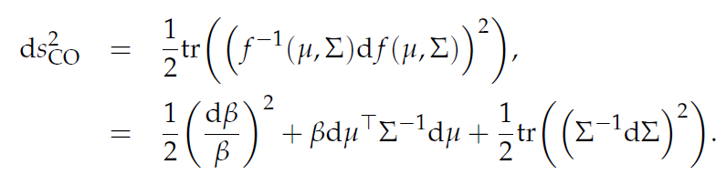
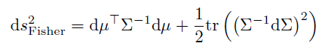
Diffeomorphic embeddings of MVN(d) onto SPD(d+1)
The diffeomorphisms {f_{β}} foliates the SPD cone P(d+1)
Using half trace metric in P(d+1), get the following metrics on MVN(d):
β=1
[Calvo & Oller 1990]
When β=1 (constant), we thus get a Fisher isometric embedding of MVN(d) into SPD(d+1):

Slide 15
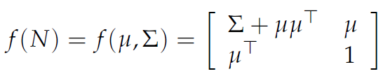
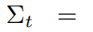
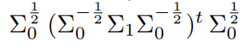
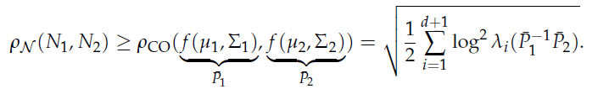
Fisher-Rao MVN distance: A lower bound
Embed isometrically the Gaussian manifold N(d) into a submanifold
of codimension 1 into the SPD cone of dimension d+1:
non-totally geodesic submanifold {f(N)}:
Use closed-form SPD geodesic in the (d+1)-dimensional cone:
SPD path is of length necessarily smaller than the MVN geodesic
in submanifold f(N). Thus get a lower bound on Rao distance:
[Calvo & Oller 1990]
β=1

Slide 16
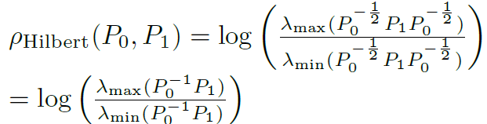
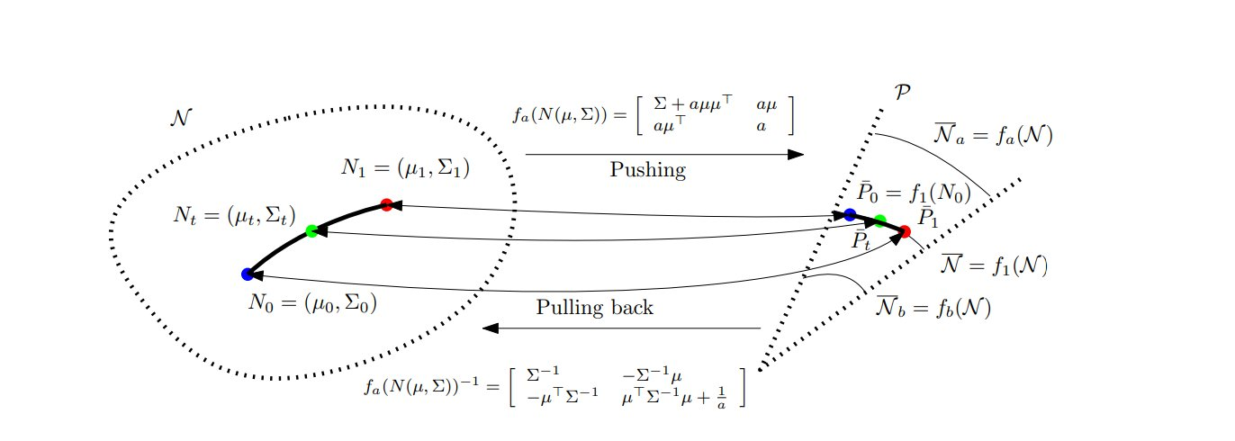
New fast distances between MV Normals
Projective Hilbert SPD distance:
Gaussian(d) manifold
SPD(d+1) cone
“Fisher-Rao and pullback Hilbert cone distances on the multivariate Gaussian manifold with applications to simplification and quantization of mixtures", ICML TAG 2023

Slide 17
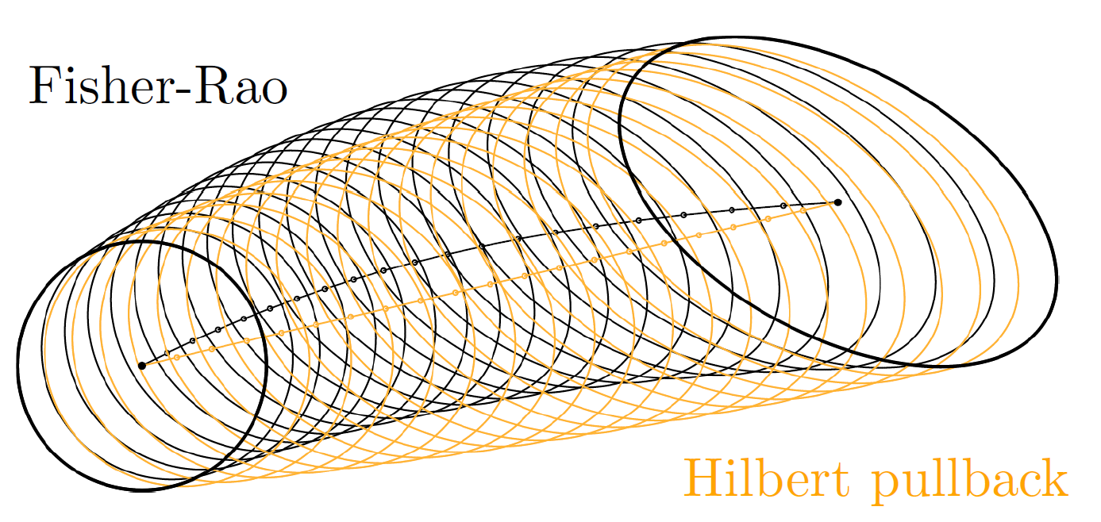
MVN Fisher-Rao distance needs approximations
by sampling geodesics, require all eigenspectrum of SPD matrices.
Hilbert SPD distance only requires to calculate extreme eigenvalues
(eg., power method iterations), + geodesics are in simple closed form
Comparison of geodesics for two bivariate normal distributions shown by ellipses centered at means
A simple approximation method for the Fisher–Rao distance between multivariate normal distributions, Entropy 25.4 (2023): 654
Fisher-Rao and pullback Hilbert cone distances on the multivariate Gaussian manifold with applications to simplification and quantization of mixtures, ICML TAG 2023.

Slide 18
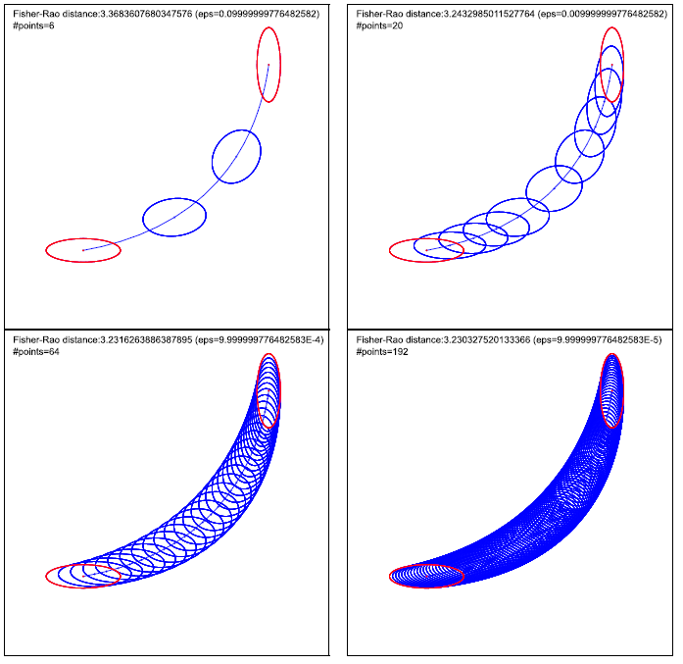
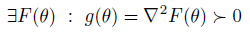
Fisher-Rao distances for MultiVariate Normals
Geodesic equation solved for boundary values recently [Kobayashi 2023]
Guaranteed 1+ε approximation algorithms [N1]
New fast distances based on Hilbert projective geometry of the symmetric positive-definite cone [N2]
General principles for approximating and bounding Fisher-Rao distances, specially when Fisher metric is Hessian:
[N3]
[K] Kobayashi, Shimpei. "Geodesics of multivariate normal distributions and a Toda lattice type Lax pair", Physica Scripta 98.11 (2023)
[N1] "A simple approximation method for the Fisher–Rao distance between multivariate normal distributions", Entropy 25.4 (2023): 654
[N2] “Fisher-Rao and pullback Hilbert cone distances on the multivariate Gaussian manifold with applications to simplification and quantization of mixtures", Topological, Algebraic and Geometric Learning Workshops 2023. PMLR, 2023.
[N3] "Approximation and bounding techniques for the Fisher-Rao distances", arXiv:2403.10089 (2024)
Notes:
ε

Slide 19
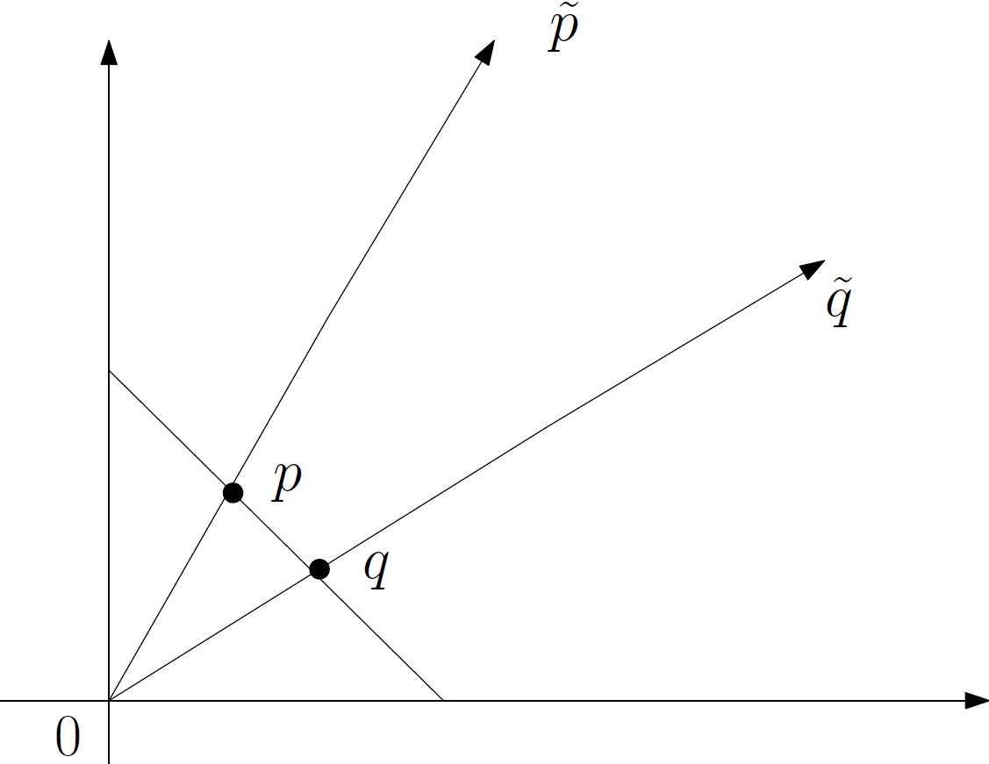
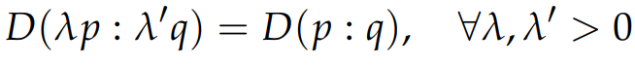
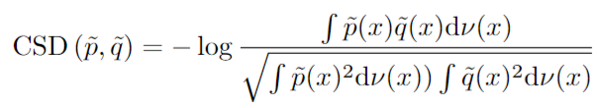
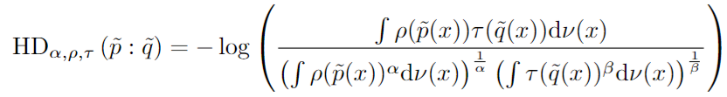
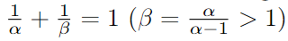
Projective divergences beyond Hilbert/Birkhoff
Projective divergences are pseudo-divergences ☺ which are invariant under rescaling of their arguments.
= Divergences between rays on the positive measure orthant cone
For example, Cauchy-Schwarz divergence:
and Hölder divergences:
N, Sun, and Marchand-Maillet, "On Hölder projective divergences." Entropy 19.3 (2017)

Slide 20





Projective divergences for statistical inference
Half-sided projective divergences are useful for estimating parameters of densities which have intractable normalizers:
For example, Hyvarinen/Fisher divergence in score matching
Empirical distribution
Intractable model
because of Z
Since we have:
Estimate unnormalized models
Notes:
N, Sun, and Marchand-Maillet, "On Hölder projective divergences." Entropy 19.3 (2017)

Slide 21

What is a “Statistical manifold”?
①
Two meanings in the literature:
① Typed statistical model manifold versus
② manifold with a dualistic structure
① Manifold of statistical models (points are typed as statistical models):
For example, the Fisher-Rao manifold of Gaussian distributions
②Manifold with a ``statistical structure’’ (differential geometry): Lauritzen coined the term “statistical manifold” for manifolds equipped with structure (g,C), a Riemannian metric tensor g and a totally symmetric cubic tensor C (next slide!)
Figure from
[Cheng et al. 2017]
Lee et al., "A statistical manifold framework for point cloud data", Intl Conf on Machine Learning, ICML 2022.
Lauritzen, "Statistical manifolds", Differential geometry in statistical inference 10 (1987): 163-216
Notes:
① ② ③
Optimal Nonlinear Estimation in Statistical Manifolds with Application to Sensor Network Localization

Slide 22


Dualistic structures of statistical manifolds: Pure geometric structures
α-manifold
0-manifold = Riemannian manifold
α -geometry from (g,C) structure
https://www.ams.org/journals/notices/202201/rnoti-p36.pdf
"The many faces of information geometry." Not. Am. Math. Soc 69.1 (2022): 36-45.

Slide 23

Dually flat spaces (M,g, ∇ , ∇ *): Bregman manifolds
A connection ∇ is flat if there exists a coordinate systemθ such that all Christoffel symbols vanish: Γ (θ) =0.
θ is called ∇ –affine coordinate system
∇-geodesic solves as line segments
Also called Hessian manifolds
"On geodesic triangles with right angles in a dually flat space." Progress in Information Geometry: Theory and Applications, 2021
Notes:
Γ θ ∇

Slide 24


Bregman manifolds in Statistics/ML
Whenever you have a strictly convex smooth function, you can build a dually flat space (M,g, ∇ , ∇ *).
Whenever you have a dually flat space (M,g, ∇ , ∇ *), you can reconstruct the convex conjugates F(θ), F*(η) , and the dual Bregman divergences
Thm: Bregman divergences = canonical divergences of dually flat spaces
In Stats/ML, we often consider exponential families with densities
It turns out that the normalizer Z(θ) partition function AND the log-normalizer F(θ)=log Z(θ) cumulant function are both convex!
So we get two dually flat spaces built from Z or F yielding Bregman divergences. Classically DFS from F was considered…

Slide 25



Two Bregman manifolds from partition/cumulants functions of exponential families, two pairs of BDs
F(θ)=log Z(θ) Z(θ)=exp(F(θ)=)
①
②
And furthermore, we can define skewed Jensen divergences from the convex generators:
①
②
Including the symmetric Jensen divergence when 𝛼=1/2:
Notes:
We can reconstruct statistical divergences from those BDs:
① ② ③

Slide 26



Statistical divergences corresponding to BDs wrt cumulant functions F of EFs
Scaled Bhattacharyya/Rényi distances
Scaled skewed Jensen divergence
for cumulant function F

Slide 27



Statistical divergences corresponding to BDs wrt partition functions Z of EFs
Amari α-divergences
Scaled skewed Jensen divergence
for partition function Z

Slide 28


KLD between normalized and unnormalized densities
with
With generalized BDs to duo Bregman pseudo-divergences:
with
Kullback-Leibler divergence between two truncated densities of a same exponential family amount to a duo Bregman pseudo-divergence
Statistical divergences between densities of truncated exponential families with nested supports: Duo Bregman and duo Jensen divergences, Entropy 24.3 (2022)

Slide 29



Comparative convexity: (M,N)-convexity
Ordinary convexity of a function:
for all t in [0,1]
Definition: A function Z is (M,N)-convex iff for in α in [0,1]:
Ordinary convexity: (A,A)-convexity wrt to arithmetic weighted mean
Log-convexity: (A,G)-convexity wrt to A/geometric weighted means:
for all t in [0,1]
for all t in [0,1]

Slide 30



Comparative convexity wrt quasi-arithmetic means
Kolmogorov-Nagumo-De Finitti quasi-arithmetic mean for a strictly monotone generator h(u):
Includes power means which are homogeneous means:
Include the geometric mean when p→0

Slide 31


Generalizing Bregman divergences with (M,N)-convexity
Skew Jensen divergence from (M,N) comparative convexity:
Non-negative for (M,N)-convex generators F, provided regular means M and N (e.g. power means)
Definition:
By analogy to limit of skewed Jensen divergences amount to
forward/reverse Bregman divergences.

Slide 32



Generalizing Bregman divergences with quasi-arithmetic mean convexity
Amounts to a conformal Bregman divergence on monotonic representations:
With generator:
Conformal factor
Remark: Conformal Bregman divergences may yield robustness in applications
Shape retrieval using hierarchical total Bregman soft clustering, IEEE Transactions on pattern analysis and machine intelligence (2012)

Slide 33
Maximal invariant: Definitions and Eaton theorem
Function f(x) is invariant under group action (G,∘) when f(g ∘x)=f(x)
A maximal invariant is a function h such that all orbits
O_{x}={h(g ∘x) | g G} for g in G have distinct values
Theorem [Eaton]:
Any invariant function is a function of a maximal invariant
Eaton, Morris L. "Group invariance applications in statistics." IMS, 1989.

Slide 34


Maximal invariance: A toy example
Consider function slope(x,y)=y/x and group of positive reals G=(R₊,*,1)
Invariant under rescaling: slope(s ∘(x,y))=slope(s*x,s*y)=y/x
Slope = maximal invariant: group orbits have different values (=slopes)
Itakura-Saito divergence is a distance used in sound processing which is also invariant to rescaling:
Therefore Itakura-Saito divergence can be expressed as a function of max invariant slope: D(y:x)=h(slope(x,y)) with h(u)=u-log u-1

Slide 35




Maximal invariance: f-divergences between scale models
Compute relative entropy (Kullback-Leibler divergence), Hellinger, chi^2, etc between location-scale (elliptical) distributions
Consider scale families of probabilities:
Those f-divergences are all invariant under rescaling:
Thus, we express them using the maximal invariant:
Calculate h_{p,f} symbolic regression from data obtained by Monte Carlo integrations of the f-divergences. Useful in practice!
Centered normal distributions
Cauchy distributions
t-Students
N and Okamura, "On f-divergences between Cauchy distributions, " IEEE Transactions on Information Theory 69.5 (2022)

Slide 36

Computing with maximal invariants
The Mahalanobis distance and Jensen-Shannon divergence (JSD) between two isotropic Gaussian distributions are invariant under translation: that is, the translation = action of group G=(R,+,0)
Mahalanobis distance is maximal invariant for the group action (after dD to 1d reparameterization…)
Thus, we have JSD(N(μ$1$, Σ),N(μ₂ ,Σ))=h(Δ_{Σ}(μ$1$, μ₂)) for a strictly monotone function h
JSD between Gaussians does not admit closed-form. Costly numerical approximations in practice!
This formula structure result allows to compare exactly JSDs:
JSD(N1,N2)<JSD(N3,N4) ↔ Δ_{Σ}(μ$1$, μ₂)< Δ_{Σ}(μ$3$, μ₄)
Since Mahalanobis distanceΔ_{Σ} can be calculated exactly!
N and Okamura, "On the f-divergences between densities of a multivariate location or scale family", Statistics and Computing 34.1 (2024)

Slide 37

Maximal invariance and hyperbolic ML
Hot topic in ML: Discrete hierarchical graph structures can be embedded in continuous hyperbolic spaces for downstream tasks
We need statistical analysis in hyperbolic spaces
How to define probability distributions in hyperbolic spaces? and statistical distances between them?
Klein disk model
of hyperbolic geometry
Probability density
N and Okamura, "On the f-divergences between hyperboloid and Poincaré distributions," GSI (2023)

Slide 38


Poincaré distributions in the upper plane
Poincaré upper plane
Triplet = Maximal invariant
N and Okamura, "On the f-divergences between hyperboloid and Poincaré distributions," GSI (2023)
Tojo and Yoshino, Harmonic exponential families on homogeneous spaces, Information Geometry (2021)

Slide 39



Slide 40
Summary: Three concepts for distances/divergences
Divergences are everywhere in information sciences!
Fisher-Rao distances: lower bounds by submanifold embeddings.
For MV normals: fast Hilbert ① projective distance using only extreme eigenvalues
② Maximal invariants for f-divergences and distances
Bregman divergences:
canonical divergences of dually flat manifolds,
duo Bregman pseudo-divergences for calculating KLD between truncated EF densities
Generarized BDs from ③ comparative convexity: conformal Bregman divergences
Notes:
① ② ③

Slide 41
Some references covering concepts in this talk
Comparative convexity:
Divergences Induced by the Cumulant and Partition Functions of Exponential Families and Their Deformations Induced by Comparative Convexity, Entropy 26.3 (2024): 193
Generalizing skew Jensen divergences and Bregman divergences with comparative convexity, IEEE Signal Processing Letters 24.8 (2017): 1123-1127
Maximal invariant:
On the f-divergences between densities of a multivariate location or scale family, Statistics and Computing 34.1 (2024): 60
On f-divergences between Cauchy distributions, IEEE Transactions on Information Theory 69.5 (2022): 3150-3171
Projective distance:
Fisher-Rao and pullback Hilbert cone distances on the multivariate Gaussian manifold with applications to simplification and quantization of mixtures, ICML TAG 2023.
Clustering in Hilbert's projective geometry: The case studies of the probability simplex and the elliptope of correlation matrices, Geometric structures of information (2019): 297-331
On Hölder projective divergences, Entropy 19.3 (2017): 122

Slide 42
Thank you!

Slide 43


Canonical divergence of cumulant functions amount to statistical reverse KLD:
We reconstruct reverse Kullback-Leibler divergence from information geometry
⇒relax to KLD between arbitrary densities
Interpretations:

Slide 44




Canonical divergence of cumulant functions amount to statistical reverse KLD:
Usually, in Statistics/ML, we prove ⇒:
where D* is dual divergence:
Let us prove ⇐ from information geometry of canonical divergence of DFS(F(θ), ϴ)
①
②
③

Slide 45
Disambiguating the term “Statistical manifold”?
Statistical model manifolds
Consider differential-geometric structures of statistical models:
Riemannian, Lie, Finsler, symplectic, contact, Hessian/Kähler, etc.
α-manifolds
0-manifolds are Fisher-Rao Riemannian manifolds
α-manifolds, specially ± 1- Hessian manifolds, can be used also in non-statistical contexts like in linear systems, time series ARMA, optimization, etc.

Slide 46
Bregman manifold: Built from a Hessian metric g
Consider a C3 strictly convex function F(θ) of Legendre-type, convex conjugate F*(η) is also Legendre-type
Compact notations for partial derivatives:
∂_{i=} ∂/ ∂ θ _{i}
∂^{i}₌ ∂/ ∂ η ^{i}
A Riemannian Hessian metric g is such that there exists θ and a potential function F(θ) such that g(θ)= ∇²F(θ) = [∂_{i} ∂_{j} F(θ)] = ∇ η(θ)
Metric g written in dual parametrization η: g(η)= ∇²F*(η)=[∂^{i} ∂^{j} F*(η)] = ∇θ(η)
θ is ∇-affine coordinate system and ηis ∇*-affine coordinate system
Cubic tensor is C_{ijk}(θ )= ∂_{i} ∂_{j} ∂_{k} F(θ) , C^{ijk}(η )= ∂^{i} ∂^{j} ∂^{k} F*(η) where ∇ and ∇* are flat because Γ_{ijk} (θ) = 0 and Γ*^{ijk} (η) = 0.
(∇+∇*)/2 is Levi-Civita connection of g, dual connections
Notes:
η

Slide 47
Canonical divergences on Bregman manifolds
Fenchel-Young equality: F(θ)+ F*(η) =< θ , η > withη = ∇F(θ) and θ= ∇F*(η).
Fenchel-Young inequality: F(θ₁)+ F*(η₂) -< θ₁ , η₂ > ≥ 0
Define Fenchel-Young divergence from the FY inequality gap:
Y_{F,F*}(θ_{1 ,} η₂)= F(θ₁)+ F*(η₂) -< θ₁ , η₂ >
Fenchel-Young divergence can be expressed as dual Bregman divergences:
Y_{F,F*} (θ_{1 ,} η₂)=B_{F}(θ_{1 ,} θ ₂)= B_{F*}(η _{2 ,} η ₁)=Y_{F*,F}(η₂, η₁)
Conversely, if (M,g, ∇, ∇*) is dually flat, meaning g is Hessian, then we have two dual potential functions from which we get two canonical dual Bregman divergences and two dual Fenchel-Young divergences.
"Divergences Induced by the Cumulant and Partition Functions of Exponential Families and Their Deformations Induced by Comparative Convexity", Entropy 26.3 (2024)

Slide 48

A geometric view of divergences

Slide 49




Information geometric measures vs OT measures
f-divergences and Bregman divergences are “vertical measures”
Optimal transport distances moves masses, “horizontal measure”
Vertical measure
horizontal measure
courtesy POT
Bregman divergence
f-divergence
Optimal transport
Notes:
Geometrical aspects of entropy production in stochastic thermodynamics based on Wasserstein distance
February 2021
License
CC BY 4.0
Muka Nakazato
Sousuke Ito
https://pythonot.github.io/auto_examples/plot_OT_1D.html
gaussian(x,mu,sigma):=(1/(sqrt(2*%pi)*sigma))*exp(-0.5*((x-mu)/sigma)**2);
plot2d([gaussian(x,0,1),gaussian(x,1,3),gaussian(x,0,1)/gaussian(x,1,3)],[x,-5,8],[color, red, blue,black],[xlabel, "x"], [ylabel, "p(x), q(x), q(x)/p(x)"], [legend, "P=N(0,1)", "Q=N(1,3)", "q(x)/p(x)"]);

Slide 50
Some open problems:
Is there some practical statistical models such that Fisher-Rao geodesics are not unique?
Closed-form for multivariate normal distributions?

Slide 51

Fisher-Rao geodesics from multivariate normals with boundary value conditions in closed form
[Kobayashi 2023]
Ingredient: Riemannian submersion and MVN geodesics from horizontal geodesics
Get closed-form geodesics with boundary values
However, no closed-form Rao distance because of the integration of length element problem

Slide 52

New fast distances between multivariate normals
Use Calvo & Oller isometric cone embedding f(μ,Σ)
In the SPD cone, use Hilbert projective metric distance
and LERP pregeodesics
Pullback the geodesics and distance into the Gaussian manifold
Projective metric on SPD
But proper metric on f(N)
“Fisher-Rao and pullback Hilbert cone distances on the multivariate Gaussian manifold with applications to simplification and quantization of mixtures", ICML TAG 2023

Slide 53
Diffeomorphic embeddings of MVN(d) onto SPD(d+1)
[Calvo & Oller 1990]
The diffeomorphisms {f_{β}} foliates the SPD cone P(d+1)
Using half trace metric in P(d+1), get the following metrics on MVN(d):
β=1
When β=1 (constant), we thus get a Fisher isometric embedding of MVN(d) into SPD(d+1):

Slide 54
Fisher-Rao MVN distance: A lower bound
Embed isometrically the Gaussian manifold N(d) into a submanifold
of codimension 1 into the SPD cone of dimension d+1:
non-totally geodesic submanifold {f(N)}:
Use closed-form SPD geodesic in the (d+1)-dimensional cone:
SPD path is of length necessarily smaller than the MVN geodesic
in submanifold f(N). Thus get a lower bound on Rao distance:
[Calvo & Oller 1990]

Slide 55




